Slide 1


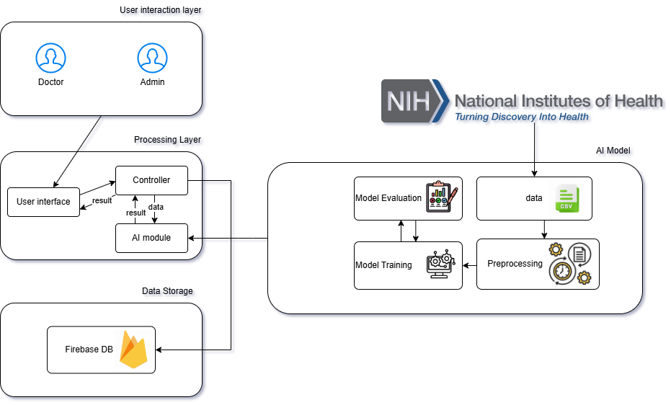

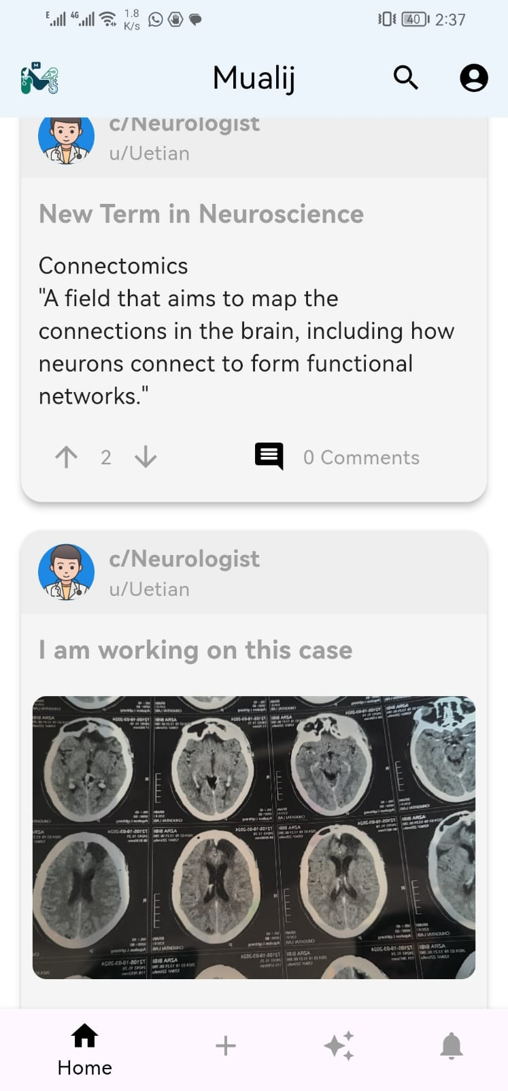
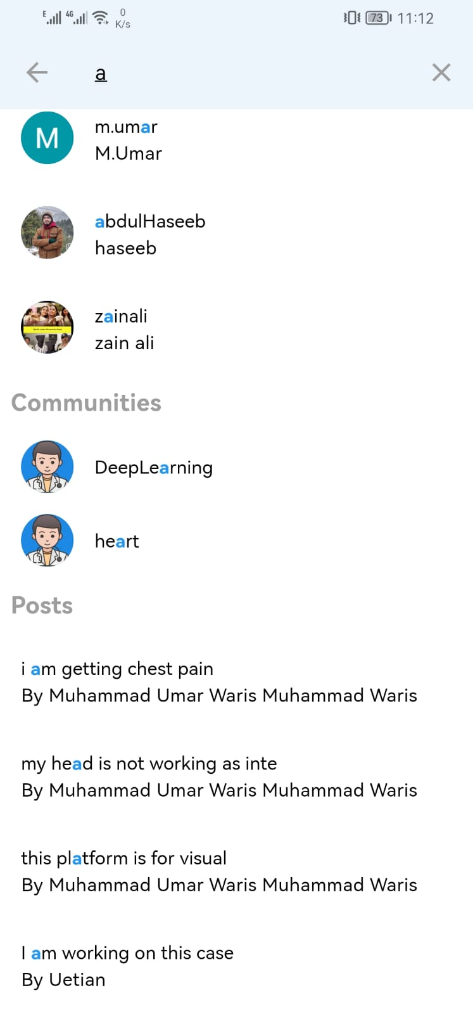
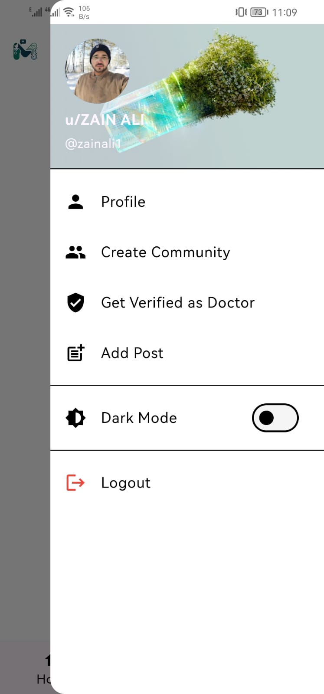
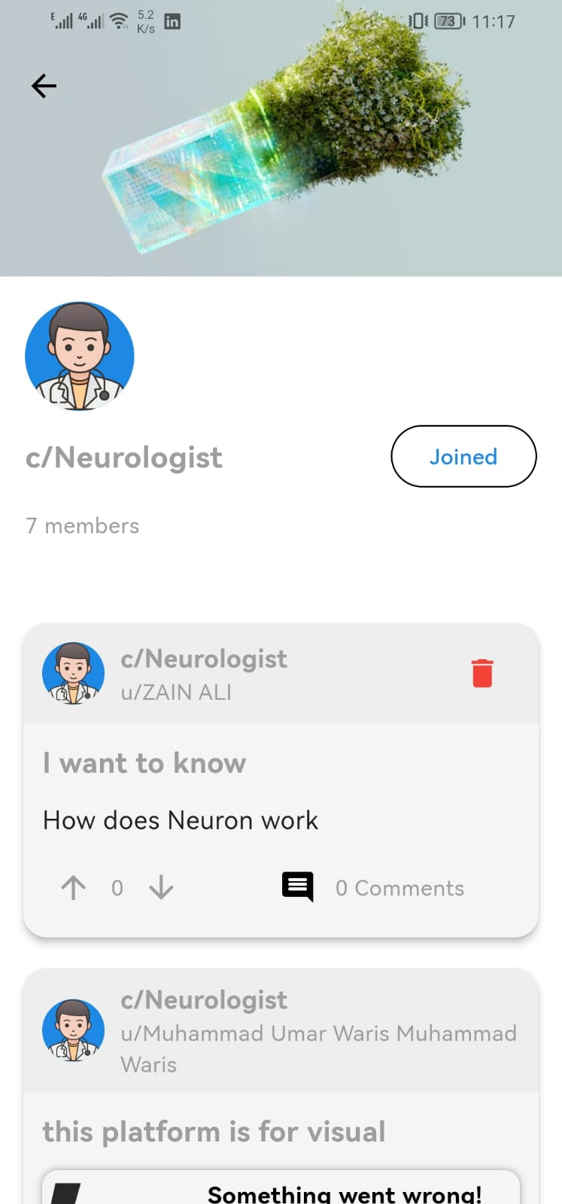
Mualij
Abdul Haseeb 2021-SE-22
Zain Ali 2021-SE-23
M. Umar 2021-SE-28
Supervisor Name: Dr. Umar Qasim
Department of CS U.E.T, New Campus
U.E.T, Lahore, Pakistan
1
2
Introduction: background, Motivation, Problem Statement
Traditional methods of doctor collaboration, like in-person meetings and outdated systems , are inefficient and lack real-time accessibility. This creates a need for modern platforms to enable seamless communication among medical professionals.
AI technologies have transformed industries, offering immense potential in healthcare. Data driven techniques can enhance decision-making for critical conditions such as cardiovascular diseases, providing doctors with timely, data-driven insights.
We propose Mualij, a doctor-to-doctor information-sharing system that enables direct information exchange, with AI-powered predictions for heart diseases(failure), and pneumonia detection using chest X-rays.
Related Work
Related Work | Weakness | Proposed Solution
Stack Overflow | Not specialized in medical queries | Develop a doctor-specific Q&A platform
HealthTap | Limited AI assistance for responses | Integrate AI to assist in answering queries
Reddit Health Forums | Reliability of answers is questionable | Allow only doctors to respond
UpToDate | Not interactive for community discussions | Add a Q&A discussion forum for doctors
Objectives
Facilitate secure and efficient knowledge-sharing among healthcare providers.
Develop a user-friendly platform for doctors to ask and answer professional questions.
Maintain a scalable and secure platform with to protect user confidentiality.
Incorporate search functionality to help doctors find relevant discussions and resources quickly.
Implement AI technology to provide accurate predictions for cardiovascular diseases(failure) and pneumonia detection.
Enable community engagement with features like upvoting, commenting, and tagging for better organization.
3
4
Features
Guest Features:
  Access the platform without registration.
  Search for posts, communities, and users.
  View questions, answers, and doctor profiles.
Verified Doctors:
  Secure registration with email verification.
  Create post and Interact with post.
  AI-based predictions for cardiovascular and pneumonia detection.
  Create and manage communities.
  Showcase professional expertise in profiles.
  Receive notifications.
Admin:
  Access the admin panel using specified credentials.
  Doctor verification.
System Architecture/ Approach/ System Design
Unverified Doctor:
  Register and log in.
  Interact with post.
  Manage personal profiles.
  Receive notifications.
  search for posts and users.
5
Working Demo
Conclusion
Mualij revolutionizes professional collaboration among doctors by providing a secure, AI-powered platform for real-time information sharing and clinical decision support. Focused on cardiovascular diseases and pneumonia, the system leverages machine learning models to deliver precise predictions, enhancing diagnostic accuracy and efficiency. Inspired by the Stack Overflow platform, it offers features such as tagging, upvoting, and commenting to facilitate organized, accessible, and interactive knowledge sharing. By ensuring secure access for verified doctors, Mualij streamlines communication, fosters community engagement, and addresses the limitations of traditional consultation methods, ultimately contributing to improved healthcare outcomes and professional collaboration.
References
1. M. Allamanis, "Why, when, and what: analyzing stack overflow questions by topic, type, and code," 10th Working Conference on Mining Software Repositories (MSR), pp. 53-56, 2013.
2. T. Gaziano, "Cardiovascular disease," in Disease Control Priorities in Developing Countries, 2nd ed, D. T. Jamison, R. G. Feachem, M. W. Makgoba, et al., Eds., Washington, D.C.
3. Z. L. a. M. Z. X. Liu, "Comparative study of ML models for heart disease and pneumonia detection using ensemble learning and CNNs," Journal of Medical Systems, vol. 46, p. 57.
4. A. M. a. N. Shukor, "Predicting heart disease using machine learning algorithms: A systematic review," International Journal of Computer Applications, Vols. 175, no. 10, pp. 1-7, 2021.
5. H. P. a. M. Shah, "Feature engineering techniques for heart disease prediction: A study of PCA and interaction terms," Expert Systems with Applications, vol. 137, pp. 302-311, 2019.
6. A. P. a. M. P. A. Dey, "Comparative analysis of machine learning algorithms for heart disease prediction," Journal of Healthcare Informatics Research, Vols. 5, no. 2, pp. pp. 233-250, 2021.

